Slide 1


Lecture #0

Slide 2

Web Performance Optimization Lecture Zero The Kick start session
CAP 785

Slide 3
Course Details
L T P-
Credit 4
Text Book
WEBSITE OPTIMIZATION: AN HOUR A DAY by RICH PAGE, SYBEX
Reference Book-
WEB PERFORMANCE IN ACTION: BUILDING FASTER WEB PAGES by JEREMY WAGNER, Manning Publications
WEB PERFORMANCE DAYBOOK by STOYAN STEFANOV, O'REILLY
HIGH PERFORMANCE WEB SITES by STEVE SOUDERS, O'REILLY
3 | 0 | 2

Slide 4
Examinations:
4 Continuous Assessments in form of Practical assignments will be held in 3^{rd,} 6th, 9th, and 12th week of the term.
No Mid Term Examination
End Term Exam will be held after week 14.
Course Organization

Slide 5
Course Assessment Model
Attendance 5
CA (3 out of 4) 45
ETP 50
Total 100

Slide 6
Assessment and Evaluation
 | Allotment weeks | Submission weeks | Marks
Lab Evaluation -1 | 3rd Week | 3rd Week | 50
Lab Evaluation 2 | 6th Week | 6th Week | 50
Lab Evaluation 3 | 9th Week | 9th Week | 50
Lab Evaluation 4 | 12th week | 12th week | 50

Slide 7
Course Outcomes
CO1 :: understand how to increase web performance by using various techniques
CO2 :: analyze websites for higher conversions and better user satisfaction
CO3 :: evaluate the performance of web resources using various metrics
CO4 :: construct websites for better user engagement and better ranking

Slide 8
Program Outcomes
Sr. No | Program Outcome (PO) | OUTCOME DESCRIPTION
1 | PO1 | Analysis & design of complex problems::Ability to apply knowledge of computer science concepts, principles & techniques to solve various computing problems.
2 | PO2 | Societal Impact::Acquire and apply advanced knowledge of concepts and participate in sustainable development.
3 | PO3 | Modern tool usage::Ability to use the modern programming languages, tools, techniques and skills necessary for design, develop and deploy software based applications.
4 | PO4 | Domain Knowledge::Ability to apply exploration to study and analyze problems in different areas of information technology.
5 | PO5 | Professionalism:: Ability to Manage time well, demonstrate an appropriate level of preparedness and maintain a high standard for personal and professional demeanor, accepting responsibility and accountability for words and actions
6 | PO6 | Research Problem Solving::Ability to assimilate, evaluate and present research results objectively
7 | PO7 | Employability::Ability to get employment opportunities in corporate/government/private sectors or to be a successful entrepreneur

Slide 9

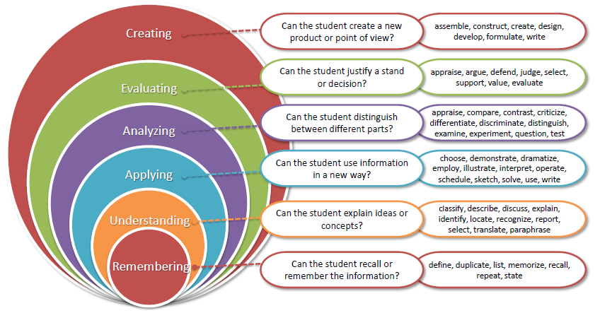
Bloom’s taxonomy
www.lpu.in Lovely Professional University
9

Slide 10

Let us re-invent ourselves
To begin with basics…
Let us go to basics.
Let us begin from toddling to learn to walk

Slide 11
Course Content
Optimizing CSS
Understanding web performance
introduction to CSS optimization
mobile-first is user-first
performance-tuning your CSS
working with CSS transitions
introduction to web performance
getting up and running
auditing the client’s website
optimizing the client’s website
performing the final weigh-in
Using assessment tools
Understanding critical CSS
evaluating with Google PageSpeed Insights
using browser-based assessment tools
inspecting network requests
rendering performance-auditing tools
benchmarking JavaScript in Chrome
simulating and monitoring devices
creating custom network throttling profiles
introduction to critical CSS,
implementing critical CSS,
weighing the benefit,
making maintainability easier,
considerations for multipage websites

Slide 12
Course Content
Making images responsive
Faster fonts
using fonts wisely
compressing EOT and TTF font formats
subsetting fonts
optimizing the loading of fonts
Introduction to image delivery
understanding image types and their applications
image delivery in CSS
image delivery in HTML
Going further with images
Keeping JavaScript lean and fast
affecting script-loading behavior
using leaner jQuerycompatible alternatives
getting by without jQuery
animating with requestAnimationFrame method
using image sprites
reducing images
encoding images with WebP
lazy loading images

Slide 13
Course Content
Boosting performance with service workers
Looking to the future with HTTP/2
need for HTTP/2
optimization techniques for HTTP/2
sending assets preemptively with server push
optimizing for both HTTP/1 and HTTP/2
introduction to service workers
writing your first service worker
updating your service worker
Fine-tuning asset delivery
compressing assets
caching assets, using CDN assets
using resource hints
Automating optimization with gulp
introduction to gulp
laying down the foundations
writing gulp tasks
working with gulp plugins

Slide 14
OPEN EDUCATIONAL RESOURCE
Course Code | Course Title | Unit mapped | Broad topic | OER Type | Title of OER | *%age unit mapped with OER (approx) | Source URL
CAP785 | WEB PERFORMANCE OPTIMIZATION | Unit 1 | Understanding web performance, Using assessment tools | Reading material (Online) | Web performance | 80% | https://developer.mozilla.org/en-US/docs/Web/Performance https://developer.mozilla.org/enUS/docs/Learn/Tools_and_testing
CAP785 | WEB PERFORMANCE OPTIMIZATION | Unit 2 | Optimizing CSS, Understanding critical CSS | Reading material (Online) | CSS performance optimization | 70% | https://developer.mozilla.org/en-US/docs/Learn/Performance/CSS
CAP785 | WEB PERFORMANCE OPTIMIZATION | Unit 3 | Making images responsive, Going further with images | Reading material (Online) | Responsive images | 70% | https://developer.mozilla.org/en-US/docs/Learn/HTML/Multimedia_and_embedding/Responsive_images
CAP785 | WEB PERFORMANCE OPTIMIZATION | Unit 4 | Faster fonts, Keeping JavaScript lean and fast | Reading material (Online) | Web fonts JavaScript performance optimization | 70% | https://developer.mozilla.org/en-US/docs/Learn/CSS/Styling_text/Web_fonts https://developer.mozilla.org/en-US/docs/Learn/Performance/JavaScript
CAP785 | WEB PERFORMANCE OPTIMIZATION | Unit 5 | Boosting performance with service workers | Reading material (Online) | Using Service Workers | 60% | https://developer.mozilla.org/en-US/docs/Web/API/Service_Worker_API/Using_Service_Workers
CAP785 | WEB PERFORMANCE OPTIMIZATION | Unit 6 | Looking to the future with HTTP/2, Automating optimization with gulp | Reading material (Online) | HTTP/2, Introduction to automated testing | 70% | https://developer.mozilla.org/en-US/docs/Glossary/HTTP_2 https://developer.mozilla.org/en-US/docs/Learn/Tools_and_testing/Cross_browser_testing/Automated_testing
**Average % age of total syllabus mapped |  | -- | --- | --- | --- | Avg.= 70%

Slide 15
Any Queries ?
www.lpu.in Lovely Professional University

